Slide 1
ML Algorithms
GENERALIZED LINEAR MODELS
K-MEANS

Slide 2
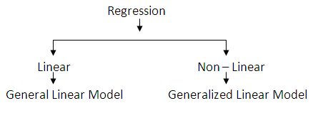
Generalized Linear Model (GLM)
A general model that unify various statistical models like linear regression, logistic regression, Poisson regression,…
GLM is a general ML model for supervised learning (both regression and classification)

Slide 3
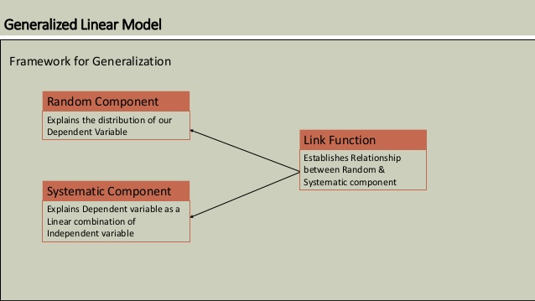
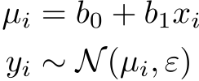
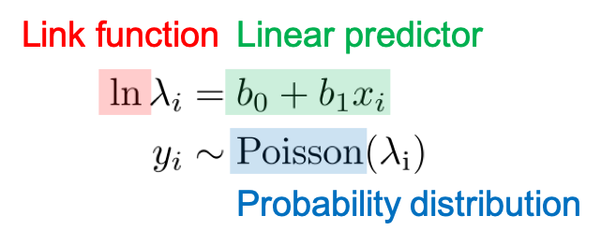
GLM
There are three components in generalized linear models.
Linear predictor also called systematic component
Link function: links the linear predictor and the parameter for probability distribution.
Probability distribution also called random component or noise model.
for linear regression: for Poisson regression:
E(µi)=

Slide 4
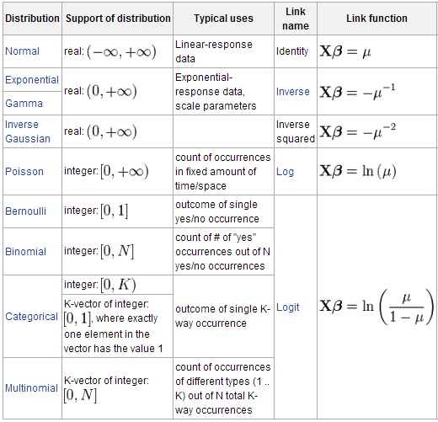
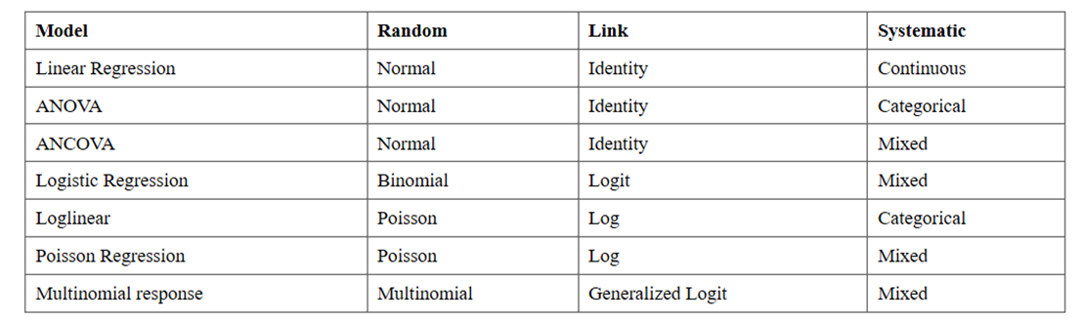
Generalized linear models
GLM TYPES

Slide 5
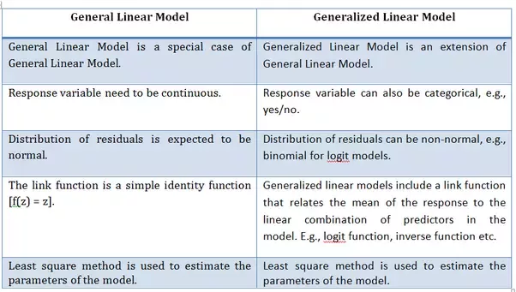
GLM
Linear model vs Generalized linear model

Slide 6
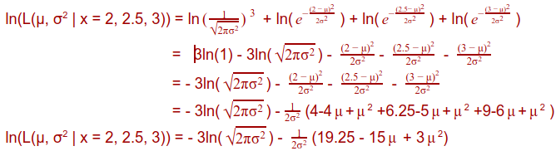




GLM
To estimate the parameters of a probability distribution,
GLM may use least square method or maximum Likelihood
estimation(MLE). supposing we have 2,2.5 and 3 as data
For linear regression:
So the PDF of Normal distribution is:
For calculating parameters, we use joint probabilities of data from we partially differentiate the equation with respect to μ
a PDF function:

Slide 7
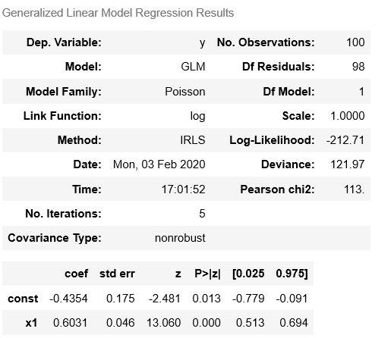
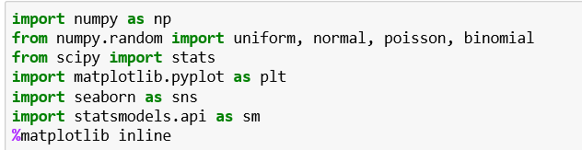
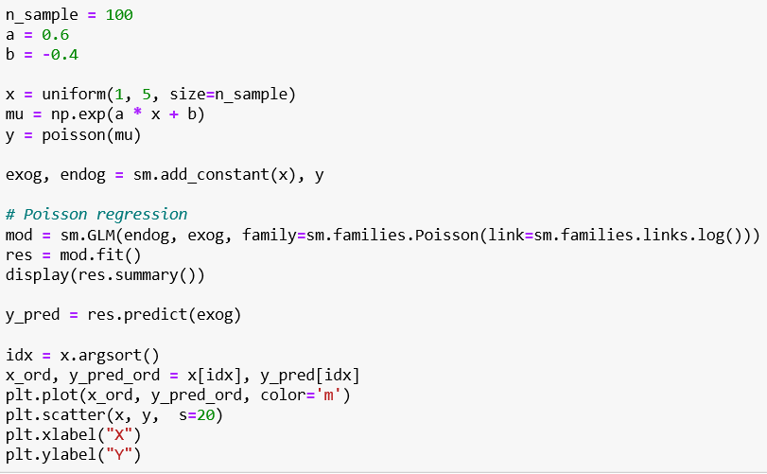
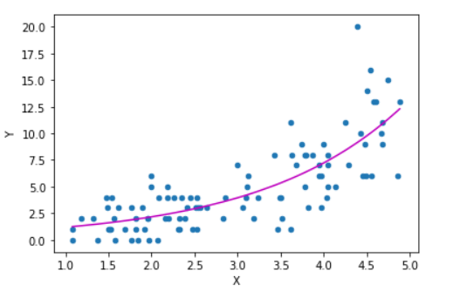
GLM in python (For Poisson regression)

Slide 8
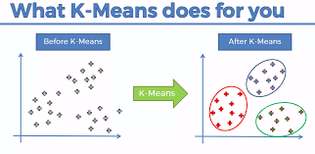
K-Means
An unsupervised learning type algorithm used for clustering.
It partitions data into K clusters in which each data belongs to the cluster with the nearest mean.

Slide 9
How algorithm works
Assuming we have inputs X_{1,} x_{2,} x_{3,…} x_{n} and value of K.
Step 1 - Pick K random points as cluster centers called centroids.
Step 2 - Assign each Xi​ to nearest cluster by calculating its distance to each centroid.
Step 3 - Find new cluster center by taking the average of the assigned points.
Step 4 - Repeat Step 2 and 3 until none of the cluster assignments change.

Slide 10
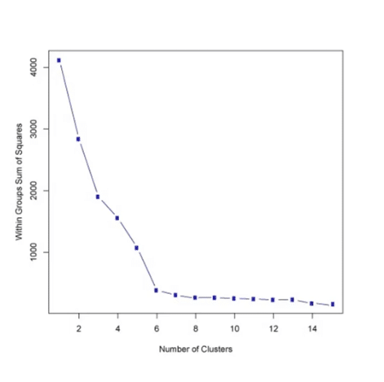
Choosing K
One of the method is known as elbow method.
First compute the sum of squared error(SSE) for some value of K. choose the value of K at which the graph decrease abruptly. This sort of produces a “elbow effect” in the picture.

Slide 11
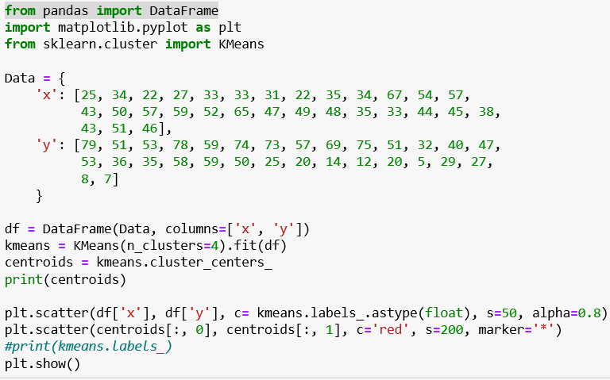
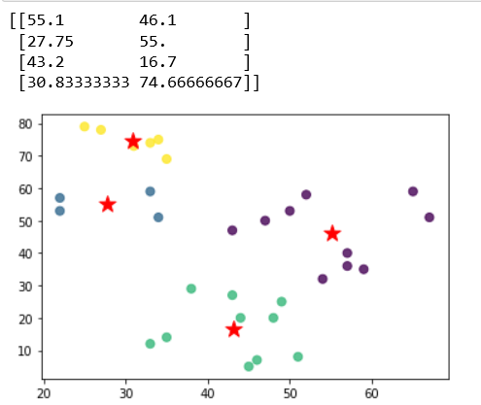
K-Means in python

